Slide 1
The history of English
For use with Chapter 1 of:
Galloway, N. and Rose, H. (2015). Introducing Global Englishes. Routledge.
© Dr. Heath Rose and Dr. Nicola Galloway

Slide 2
Overview
The origins of the English language
The early spread of English around the world
Globalization and the rise of the world’s lingua franca
Representing English speakers

Slide 3
Introductory activities
Look at the map (Figure 1.1 in the introduction to Chapter 1) and discuss the questions below.
How did English become the official language of so many nations?
English has developed from being the mother tongue language of a few countries to being the world’s global lingua franca. Why has English become a global language and reached such global status? Why English and not another language?
Mauranen (2012) points out that ‘we can, without hesitation, place ELF [English as a lingua franca] among one of the most important social phenomena that operate on a global scale; it is on a par with things like global economy, mobility and the Internet, and closely intertwined with them. The emergence of one language that is the default lingua franca in all corners of the earth is both a consequence and a prerequisite of globalisation’ (p. 17).
What does Mauranen mean by this statement?
How has globalization contributed to the spread of English to regions further than those highlighted on the map?
A number of frameworks to represent English speakers around the globe have been proposed. However, it is difficult to categorize how English is used by people around the world (e.g. as a native language, a second language).
What difficulties might you encounter trying to categorize English speakers? Why is it difficult?
How would you categorize the following countries based on English usage?
Australia, Singapore, Denmark, USA, Germany, Canada, China, Hong Kong, England, The Philippines, Ireland, Brazil, The Netherlands, New Zealand, Japan, South Africa, Iran, Jamaica, Saudi Arabia, Kenya, Italy, India, Mexico

Slide 4
The origins of the English language
Part 1

Slide 5
Early historical development
Old English develops
Ancient Britons and Romans
Romans leave England
Anglo-Saxon invasion:
Angles, Saxons and Jutes move in to fill the power void
Nordic invaders settle in parts of Britain
300 1100
Germanic languages arrive. These new languages and migrant communities pushed ‘the indigenous population into “corners” such as Wales and Cornwall’ (Melchers and Shaw 2011, p. 1) where remnants of the ancient Celtic languages remain today in local languages including Cornish and Welsh
Old Norse introduced and mixes with developing languages
Ancient Celtic languages (e.g. ancestors of Gaelic, Welsh and Cornish)

Slide 6
An example of Old English
An excerpt from Beowulf from 900 ad:
Hwæt wē Gār-Dena in geār-dagum
þēod-cyninga þrym gefrūnon
hū ðā æþelingas ellen fremedon
Oft Scyld Scēfing sceaþena þrēatum
monegum mægþum meodo-setla oftēah
egsian eorl syððan ǣrest weorþan
English language underwent massive change during the time of Old English. This change was accelerated with the introduction of French into England in the eleventh century, brought by the Normans who lived in the northern area of what is France today.

Slide 7
French-speaking government for 300 years
Changed English dramatically
McIntyre (2009): ‘Of course, the language did not change overnight but gradually French began to have an influence that was to change English substantially and lead it into its next stage of development – Middle English’ (p. 12)
Norman – language of kings and nobles
English was an endangered language (Melchers and Shaw, 2011)
By this time English had changed dramatically
More than 10,000 French words had entered the English language and grammatical changes occurred (Baugh and Cable, 2002)
Midlands variety of English
Associated with prestige and power
The language of government and the courts
Norman Conquest
(1066)
English returns
(1394)
Chancery Standard
(1400s)
1100 1450
Norman French has huge impact on English
Other influences include Latin
(through the church and sciences)

Slide 8
An example of Middle English
An excerpt from The Canterbury Tales from 1400 ad:
His Almageste, and bookes grete and smale,
His astrelabie, longynge for his art,
His augrym stones layen faire apart,
On shelves couched at his beddes heed;
His presse ycovered with a faldyng reed
And al above ther lay a gay sautrie,
On which he made a-nyghtes melodie
So swetely that all the chambre rong;
And Angelus ad virginem he song;

Slide 9
Emergence of a standard English language
The notion of standardization of English had started to occur during the early 1400s – before this time the English dialects varied greatly.
The concept of a unified English language started with the spread of written English (for government administrative writing Chancery English was chosen) ‘not only because the Midlands are located in the middle, but because the language was not as extreme as that of the innovative North or as conservative as in the south’ (Gramley, 2012, p. 104).
Hogg and Denison (2006) on why the Midlands variety became the standard:
The dialect was spoken by the largest number of people
The area was wealthy in agricultural resources
Influential arms of government and administration were located there
The area was associated with education and learning, with Cambridge and Oxford universities in close proximity
It contained good ports
It had strong ties to the church and the Archbishop.
Emergence of a standard written English was related to political, social, religious, economic, and educational support – factors that influence the rise of prestige varieties today.

Slide 10
Emergence of a standard English language
English differed greatly but the printing press did much to unify the English language as a single language, as opposed to mutually unintelligible dialects:
And that common English that is spoken in one shire varies from another, so that in my days it happened that certain merchants were in a ship on the Thames to sail over the sea to Zealand, and for lack of wind, they tarried at Foreland, and went to land to refresh themselves. And one of them named Sheffelde, a mercer, came to a house and asked for food, and especially he asked for egges, and the good woman answered that she could speak no French. And the merchant was angry, for he also could speak no French, but wanted to have egges, and she did not understand him. And then at last another said that he wanted eyren. Then the good woman said that she understood him well. Lo, what should a man in these days now write, egges or eyren? Certainly it is hard to please every man, because of diversity and change of language. (Caxton, 1490)

Slide 11
Early Modern English emerges
The acceptance of a written ‘standard’ English did not really occur until centuries after Caxton’s first printed publications.
During the next century Britain saw massive writing and spelling reforms, the publication of influential English language dictionaries, and focus on ‘correct’ grammar rules – gravitation towards these standard written conventions.
Power and prestige attached to the Midlands variety of English – McIntyre (2009) states: ‘the dialect was associated with powerful people – and, as we have already seen, power equals prestige’ (p. 22).
English also went through the Great Vowel Shift – an upper class distinguishing their ‘correct’ pronunciation from the lower class, and consolidation of the differences in spelling and pronunciation at the time (Gramley, 2012).
Modern English was the result of a chain reaction:
Began with attempts at standardization
Gained momentum with the printing press
Cemented itself with the attitudes at the time of prestige associated with the new standard

Slide 12
The early spread of English around the world
Part 2

Slide 13
Two diaspora of the British Empire (e.g. Jenkins, 2009b)
British Empire
North America
2nd diaspora (trade colonies)
Creation of new ESL colonies
Australia and New Zealand
1st diaspora (migration)
Creation of new ENL colonies
Singapore
India
West African coast
Caribbean
A pidgin is a contact language with no native speakers which develops when those who wish to communicate must find or improvise a simple language system.
A creole is often defined as a pidgin that has become the first language of a new generation of speakers.

Slide 14
The problem with the two diaspora model
Not connected to how the English language actually spread:
How English spread to the Caribbean is very different to how it spread to the USA and Canada.
How English spread to exploitation colonies was also very different to the Caribbean.
Doesn’t provide a chronological account of actual spread:
First diaspora to Australia and New Zealand happened after second diaspora to India/West African coast.
The first diaspora is largely said to occur in the eighteenth century, while the second diaspora ‘took place at various points during the eighteenth and nineteenth centuries’ (Jenkins, 2007, p. 7). However, British influence began in India in the early 1600s, well before the beginning of the spread of English to many parts of the world during the first diaspora (McCrum et al., 1992, p. 356).

Slide 15
How to examine spread?
The best that can be said is that the historic spread of English language through, trade, colonization, and slavery was not a single concerted effort to impose the English language on the world, but that the spread of the English language was incidental to the expansion of the British Empire and the increased influence of Britain on the world. Galloway and Rose (2015) – 4 channels:
Settler colonies
Slavery
Trade and exploitation colonies
Globalization (recent spread)

Slide 16
Figure 1.2: The four channels of English spread (p. 8)
English
Channel Two
Slavery
Channel One
Settler colonization
Channel Three
Channel Four
Trade and exploitation colonies
Globalization
e.g. the spread of English to convict settlements in Australia
e.g. the spread of English to plantations in Jamaica
e.g. the spread of English to local trading ports in India
e.g. the spread of English to China

Slide 17
Mercantilism
Trade is a ‘zero sum’ game.
Nations sought to expand their resources for trade through:
Exploration and colonization of new territories (USA, Australia etc.)
Colonization of known lucrative ports and markets (e.g. India)
Expansion of labour resources (e.g. slavery).

Slide 18
Channel 1: Settler colonization
Expansion into America began in early 1600s:
‘by 1640 there were 25,000 English speakers in New England alone’ (Melchers and Shaw, 2011, p. 6).
The British Empire spread to Australia and New Zealand:
Australia initially by convicts, then free settlers
New Zealand by free settlers.
Indigenous populations treated poorly resulting in minimal impact on the English language:
e.g. Australia’s ‘white policy’ ran until 1969 and involved the removal of 6,000 aboriginal children from their parents for the purposes of ‘white education’.

Slide 19
Channel 2: Slavery
Even though slaves were bought to new territories (America, the Caribbean), the impact on language was vastly different:
Communities of displaced African populations from diverse linguistic backgrounds
English was a contact language in areas of little L1 input
Pidgins emerged, which developed into creoles with subsequent generations
With independence, new ENL countries emerged (e.g. Jamaica).

Slide 20
Channel 3: Trade and exploitation colonies
Britain aimed to control markets that would add to its trading power:
Heavy interest in lucrative markets (India) and important trading ports (Singapore, Hong Kong, along West African coast)
English was used as a jargon in less important trading ports (pidgins emerged)
In important trading ports English was implemented as an official language of education and administration
even though colonial control was often established and English was introduced as the language of administration and education, these were areas where few native English speakers settled – English was mostly (but not always) used as an additional language to the local languages (Gramley, 2012).

Slide 21
Globalization and the rise of the world’s lingua franca
Part 3

Slide 22
Channel 4: Globalization (1)
English is now an undisputedly global language:
The British Council (2014) lists 88 countries (60 sovereign and 28 non-sovereign states) where English has official status.
Other sources state English has a significant role in 90 countries in total – 70 of which in an official or semi-official capacity (McArthur, 2002, p. 3).
Official or working role in international diplomacy, major political gatherings and in international organizations. ‘The overriding assumption is that, wherever in the world an organization is based, English is the chief auxiliary language’ (Crystal, 2003, p. 89).
75% of the world’s mail and electronically stored information (McArthur, 2002).
English radio programmes are received by 150 million people in over 120 countries (Crystal, 2008, p. 4).

Slide 23
Channel 4: Globalization (2)
Dominates popular culture.
Lingua franca of air traffic control, civil aviation and shipping.
Universal in many academic disciplines, workplaces, international communications and publications, and the leading language of science, medicine, and technology. The Web of Science database of ‘top-tier’ journals places emphasis on using English as the medium of publication, stating that for a journal to be listed ‘full text English is highly desirable, especially if the journal intends to serve an international community of researchers’ (Thomson-Reuters website).
Most widely taught foreign language, with over 1 billion English learners worldwide (McKay, 2012, p. 28).
Involved in more language-contact situations than any other language.

Slide 24
Why English?
Historically, other lingua franca languages’ rise to dominance had little to do with linguistic qualities
English was at the right place at the right time (Crystal, 2003)
Language-internal qualities?
Few complex grammatical endings
No gender differences
Mixed vocabulary
Flexible language
Language-external qualities?
British imperialism contributed to initial spread
USA became a major global power
Dominance of USA when globalization gathered steam

Slide 25
English speakers today
English as a lingua franca (ELF) on a worldwide scale is a relatively new phenomenon.
‘On this count, we are living in the first generation of ELF’ (Mauranen, 2012, p. 3).
Speakers are (problematically) categorized into three groups:
English as a native language (ENL)
English as a second language (ESL)
English as a foreign language (EFL).
Is ‘EFL’ a misnomer?
Has English become more than a mere ‘foreign’ language?
Better to describe as ‘ELF speakers’?

Slide 26
Number of English speakers
Difficult to estimate for sure, but it is said (Crystal, 2003):
There are between 320-380 million ENL speakers
There are between 300-500 million ESL speakers
More than 1 billion EFL/ELF speakers.
There is no single source of statistical information on language totals. Crystal used the UNESCO statistical yearbook, The Encyclopaedia Britannica Yearbook, Ethnologue: Languages of the World, and census data to calculate the above estimates. These figures are controversial and EFL estimates are particularly difficult to assess due to problems identifying how to determine proficiency.
There are now more non-native speakers of English than native speakers of English

Slide 27
Representing English speakers
Part 4

Slide 28
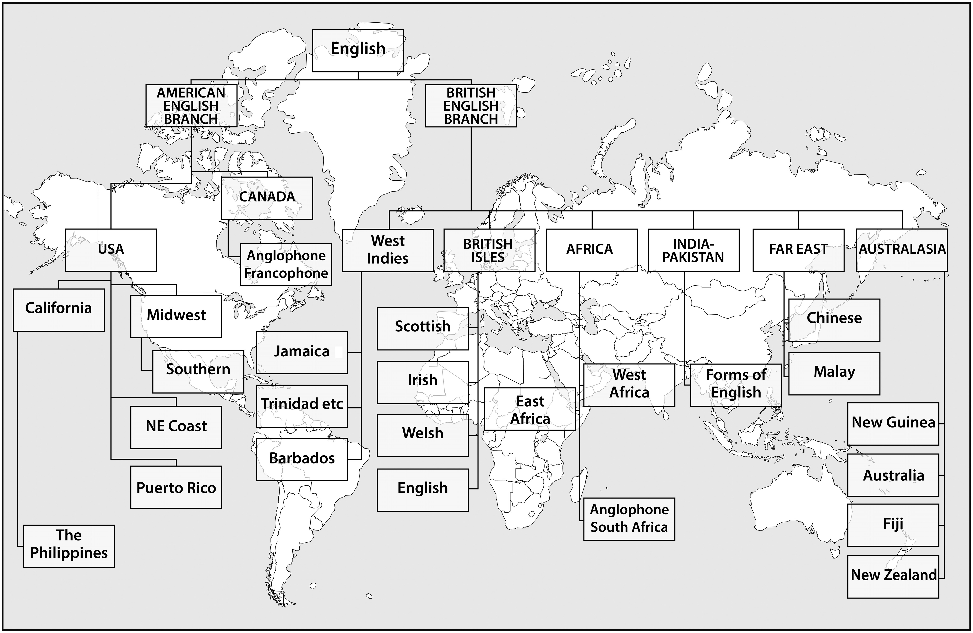
Figure 1.3: Strevens’ World Map of English, which has been reproduced here in a slightly altered form. (For the original see Strevens 1980, p. 86.)
Weaknesses:
American centric and historically flawed (e.g. Irish English)
Strengths:
Highlights historic and geographic relationships between the Englishes

Slide 29
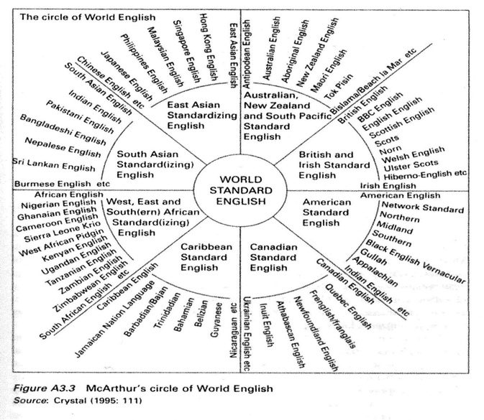
Figure 1.4: McArthur’s Circle of World English (© Cambridge University Press, reproduced with permission)
Strengths:
Tidy depiction of Englishes according to geography
Weaknesses:
Not indicative of historic, political, or linguistic ties between Englishes (e.g. Philippines–America, Hong Kong–UK)

Slide 30
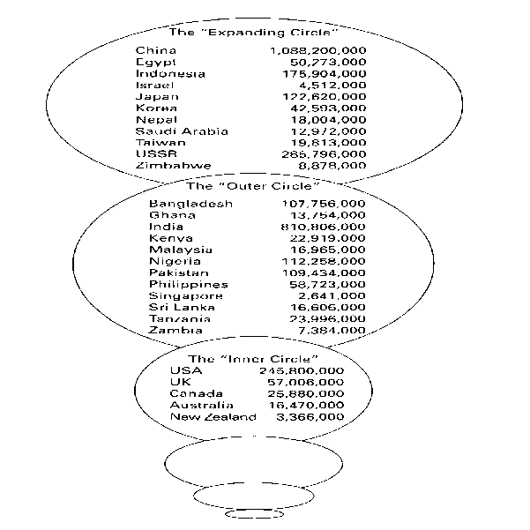
Figure 1.5: Kachru’s Three Circle Model, reproduced with permission
Influential in raising awareness of World Englishes
Follows categorization of speakers
Commonly used

Slide 31
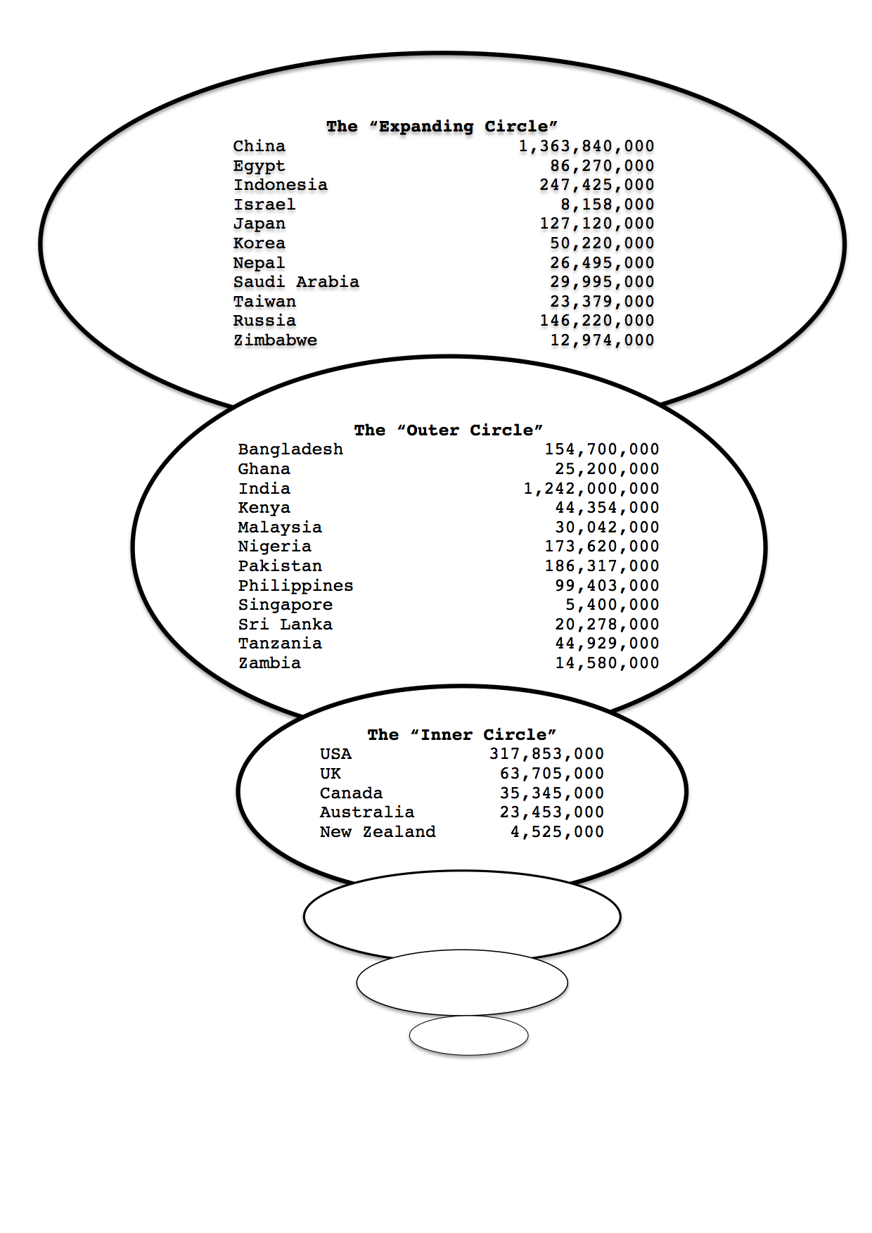
Figure 1.6: An adapted version of Kachru’s Three Circle Model of World Englishes using
data reflecting estimated national population figures in 2014

Slide 32
Criticisms
Despite its usefulness, there are flaws as outlined by Galloway and Rose in the book (also Bruthiaux, 2003; Jenkins, 2003).
As outlined in Introducing Global Englishes, it:
Overly emphasizes geographic and historical factors
Is too focused on colonial history
Fails to capture the true role of English in multi-ethnic and monolingual territories
Assumes a monolithic standard
Distributes pidgins and creoles across all three categories.
Notes:
Jenkins 2003

Slide 33
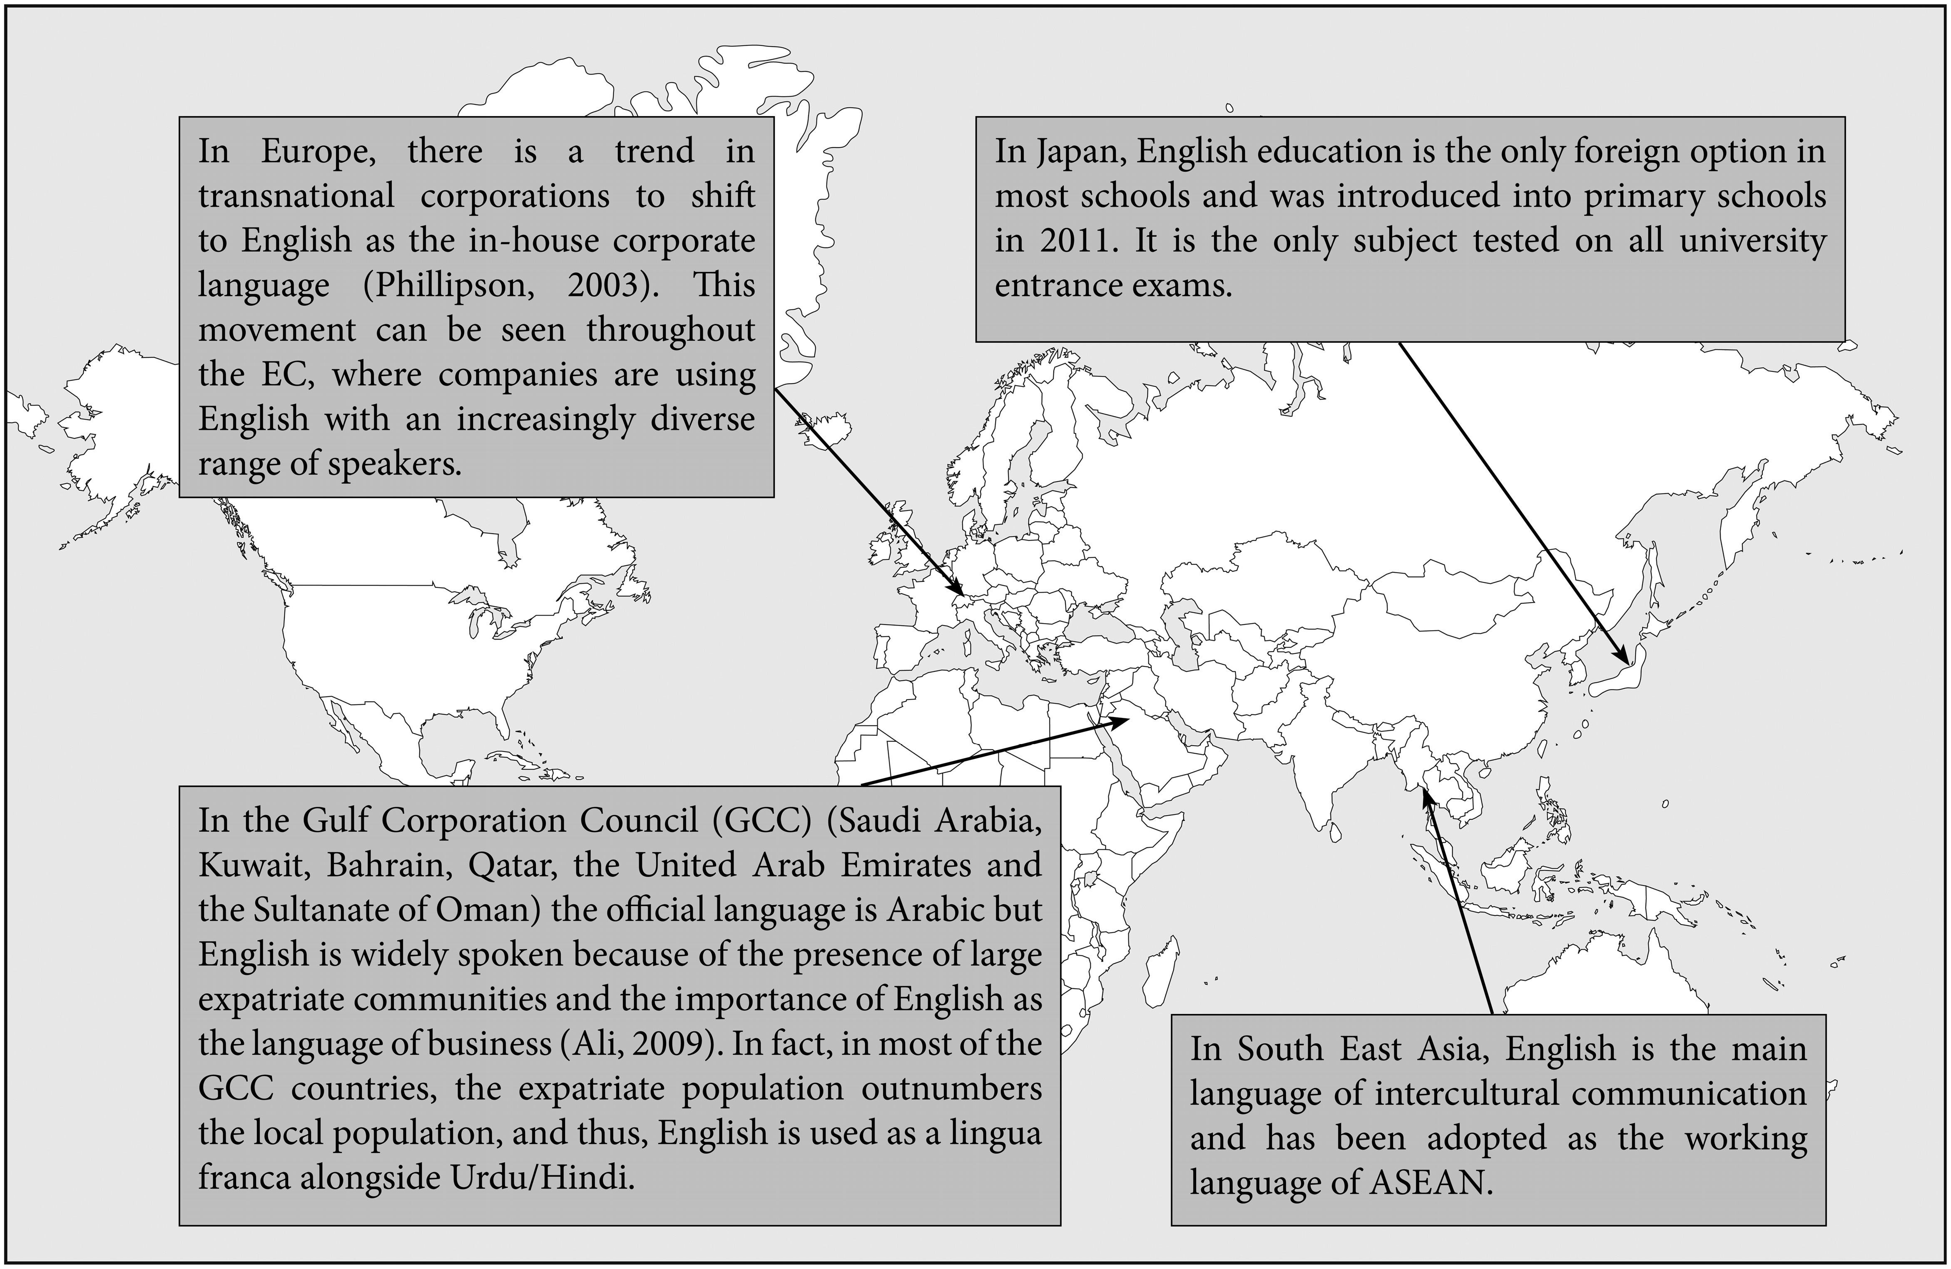
1. Overly emphasizes geographic and historical factors
Figure 1.7: English use around the globe

Slide 34
ELF is used both within and across these three circles
This ‘superficially appealing and convenient model conceals more than it reveals’ (Bruthiaux, 2003, p. 165).
Pennycook (2007, p. 22):
the pluralization of English leaves out all those other Englishes which do not fit the paradigm of an emergent national standard – in doing so, it ‘falls into the trap of mapping centre linguists’ images of language and the world in to the periphery’
Is an ‘exclusionary paradigm’ that ‘does little more than pluralize monolithic English’.

Slide 35
2. Is too focused on colonial history
Mandate in many countries not in Kachru’s Outer Circle:
e.g. Britain occupied Egypt from 1882 and Egypt officially became a British protectorate at the end of the First World War, which is much longer than the American colonization of the Philippines (Bruthiaux, 2003).
But Egypt is in the EC while the Philippines is in the OC.
Britain also had a brief mandate in countries including Jordan, Iraq, Palestine, and Kuwait).
Bruthiaux (2003):
It overlooks regions in countries that have heavy colonial influences, such as Cameroon, which has more than 6 million non-native English speakers.
English also represents a prestige language in many countries that were never subjected to English-speaking colonization, e.g. multi-ethnic Ethiopia and various parts of Central America (Bruthiaux, 2003, p. 166).
Colonial history is not sufficient to understand the complex sociolinguistic uses of English in the world today.

Slide 36
3. Fails to capture the true role of English in multi-ethnic and monolingual territories
Changing status of English in many regions:
Canada and South Africa are very multilingual, yet in this model they are categorized as ENL/IC speakers, ignoring the French Canadians and Bantu.
Strongly multilingual Nigeria, Mauritius, and Singapore, for example, use English in a variety of official and unofficial roles in international and internal communication (Bruthiaux, 2003, p. 165).
Singapore – many speak English as a first language, or perhaps grow up bilingual or multilingual.
Despite their colonial history, Bangladesh and Hong Kong tend to limit English internally for commercial, legal and educational functions.

Slide 37
Many IC/ENL territories are not homogeneous and are not ‘ENL only’, for example:
USA: 51 million speak Spanish as their main languages (2009 US Census Bureau American Community Survey).
UK: many have Gaelic, Welsh, or one of several Asian languages as their first language; in 2013 Polish was reported as the second largest spoken language in England, putting the 500,000 native-Polish speakers ahead of Punjabi (273,000), Urdu (269,000), Bengali (221,000), and Gujarati (213,000), which account for 1 million speakers combined.
Australia: 1996 census showed 15% of the population spoke another language at home.
A lot of the world is now bi- or multilingual, and English is often spoken within a framework of code mixing (blending English with another language) and code switching (switching back and forth between English and another language), e.g.:
Wales: English is sometimes mixed with Welsh.
Canada: English is sometimes blended with French.

Slide 38
4. Assumes a monolithic standard
IC as a yardstick of measurement.
Kachru’s (1985, p. 2) ‘norm-providing’ IC, ‘norm-developing’ OC, and ‘norm-dependent’ EC.
Both Jenkins (2009b) and Bruthiaux (2003, p. 169) note the difficulty in using the model to define speakers in terms of their proficiency in English, and the lack of an attempt to differentiate between degrees of communicative competence.
‘The fact that English is somebody’s second or third language does not of itself imply that their competence is less than that of a native speaker’ (Jenkins, 2009b).
‘Native-speakership’ is defined by birth right and is assumed to be superior to a ‘foreign’ user.
Assumes a monolithic view of English and English is seen as the property of the ENL speakers.
Division between native English speakers and non-native English speakers.
‘By over simplifying in this manner, the model offers an incomplete and potentially misleading representation of one of its major components’ (Bruthiaux , 2003, p. 162).
Gives the impression that IC/ENL/NE is a single variety of English.

Slide 39
5. Distributes pidgins and creoles across all three categories
English-based pidgins and creoles do not fit into Kachru’s model since they may run across the three categories:
in ENL settings (e.g. the Caribbean)
in ESL settings (e.g. in many territories in West Africa)
in EFL settings (e.g. Nicaragua, Panama, and Surinam in the Americas).
Creoles exist officially alongside ‘standard’ English, such as in Papua New Guinea, the Solomon Islands, and Vanuatu.
Are creoles:
varieties of English
separate languages?

Slide 40
Summary of criticisms
An inclusionary political agenda, but exclusionary.
Canagarajah (1999a, p. 180): in Kachru’s ‘attempt to systematise the periphery variants, he has to standardise the language himself, leaving out many eccentric, hybrid forms of local Englishes as too unsystematic. In this, the Kachruvian paradigm follows the logic of prescriptive and elitist tendencies of the centre linguists.’
‘A 20th century construct that has outlived its usefulness’ (Bruthiaux, 2003, p. 161).
English speakers do not fit nicely into one of the three circles.
Globalisation, migration, and computer-mediated communication have changed the nature of interaction in English – ELF doesn’t fit neatly into the model.
However:
influential in raising awareness of varieties of English
expanding implies a process of growth.
‘This model has thus instilled increasing self-confidence in localised varieties of English and strongly influenced language teaching and applied linguistics in countries of Asia and Africa in particular’ (Schneider, 2011, p. 32).
Notes:
Schneider

Slide 41
A note on alternative models
Modiano’s Centripetal Circles of International English (1999a)
English as an International Language (EIL) (Modiano, 1999b)

Slide 42
Summary of Lecture 1
English has spread from its roots in the Germanic languages spoken by the Anglo-Saxons 1500 years ago to become a global lingua franca.
A historical overview of English has shown that English is not a monolithic entity, but one that adapts and changes according to its surroundings:
The English language has changed dramatically over the last 10 centuries, since its emergence from the Old Norse-influenced Germanic Anglo-Saxon languages of the first millennium.
There have been huge influences from later languages such as Norman French and Latin, to name just two.
English has indeed become a world language in the realms of business, politics, communication, technology, pop culture, and academia.
English’s journey to becoming the world’s language was largely due mercantilist policies of Britain, and to its position as the language of the US at the time of globalization.
English has reached a position where it is spoken as a native or second language by more than 700,000 people, and is a foreign language to more than 1 billion.
As a result, non-native speakers now outnumber native speakers, which has extraordinary implications for the ownership of English.
Because of history, it is difficult to categorize the world’s speakers of English.
While this class continues to use Kachru’s Three Circle Model, the limitations of this method of categorization have been bought to the forefront.

Slide 43
Key terms
Old English (OE) Middle English (ME) ‘Standard’ English Chancery English, Chancery Standard Contact language Pidgin Creole Two diaspora First diaspora Second diaspora Settler colonization Trade and exploitation Colonies Globalization Mercantilism English as a native language (ENL) English as a second language (ESL) English as a foreign language (EFL) English as a lingua franca (ELF) | Expanding Circle (EC) Outer Circle (OC) Inner Circle (IC) Native English (NE) Native English speaker (NES) Non-native English speaker (NNES) World Englishes (WE) Code-mixing Code-switching Lingua franca Prestige Contact language ‘New’ Englishes Unintelligible Slavery Jargon Englishes World standard English

Slide 44
Further reading
On the history of the English language and the historical spread:
McIntyre, D. (2009). A History of English: A Resource Book for Students. London: Routledge.
On the rise of English as a lingua franca:
Crystal, D. (2003). English as a Global Language (2nd edition). Cambridge: Cambridge University Press.
On evaluations of models of World Englishes:
Bruthiaux, P. (2003). ‘Squaring the circles: issues in modeling English worldwide.’ International Journal of Applied Linguistics, 13(2), pp. 159–178. doi: 10.1111/1473-4192.00042

